Slide 1
New Automation Technology Beckhoff Automation

Slide 2
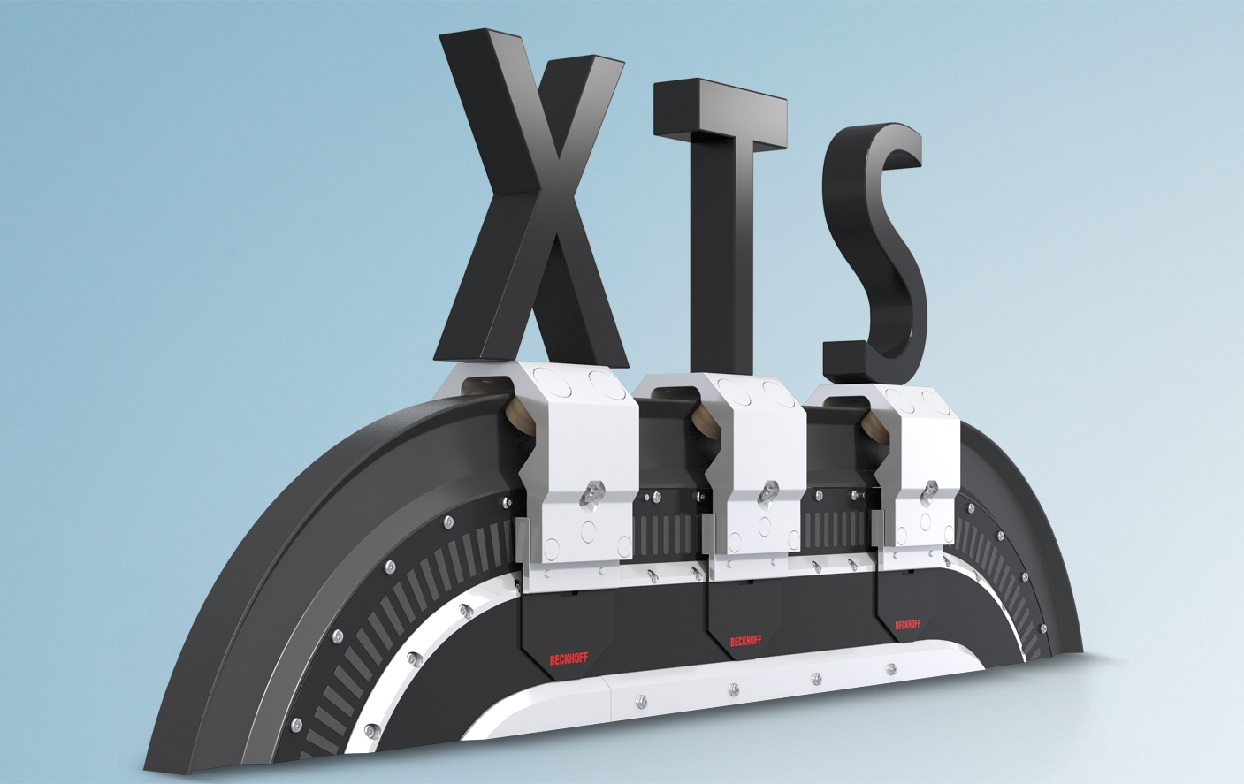
XTS Training

Slide 3
XTS – PLC

Slide 4
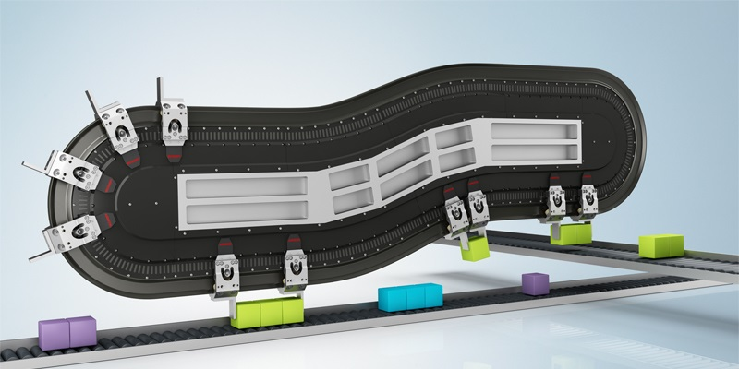
Agenda | XTS – PLC
PLC-Library XTS
AXIS_REF
XTS-Utility Library
PLC StartUp condition
Mover1 detection via PLC
Overview TF5400 Collision Avoidance (CA)
CA-Group Object
PLC-Library CA-Group
AXES_GROUP_REF
CA-Group handling
CA-Operation

Slide 5
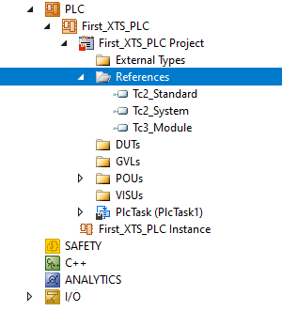
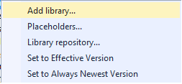
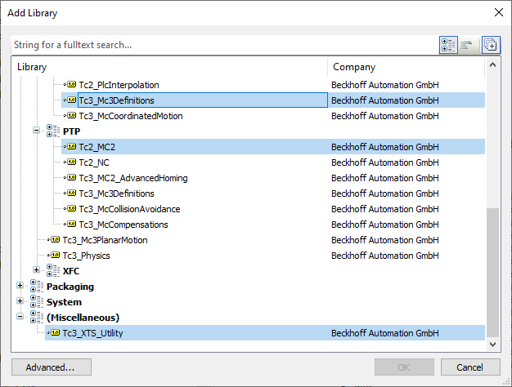
XTS PLC Libraries
Necessary PLC-Libraries
XTS

Slide 6
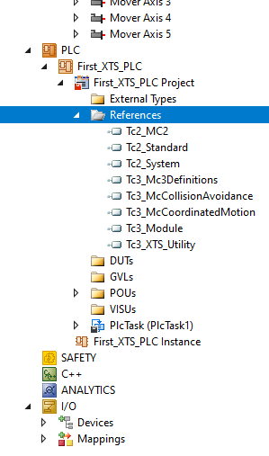
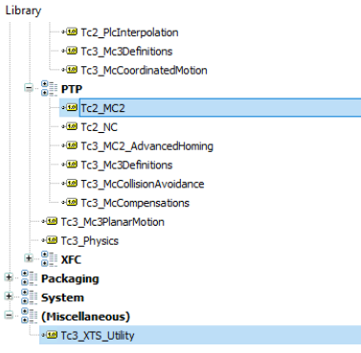
XTS PLC Libraries
Necessary PLC-Libraries
XTS
Tc2_MC2
Library containing PLCOpen standardized motion control function blocks
Tc3_XTS_Utility
Library containing Diagnosis and Visualization for the XTS-System

Slide 7
Agenda | XTS – PLC
PLC-Library XTS
AXIS_REF
XTS-Utility Library
PLC StartUp condition
Mover1 detection via PLC
Overview TF5400 Collision Avoidance (CA)
CA-Group Object
PLC-Library CA-Group
AXES_GROUP_REF
CA-Group handling
CA-Operation

Slide 8
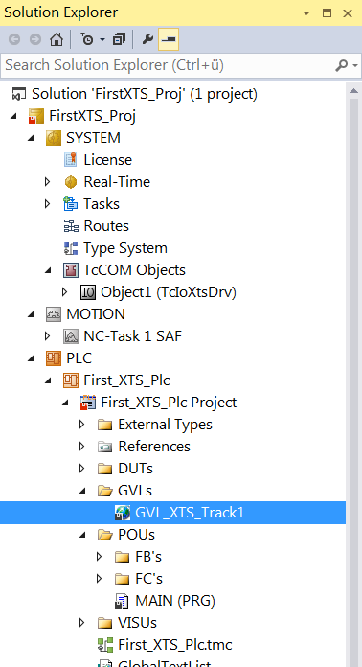
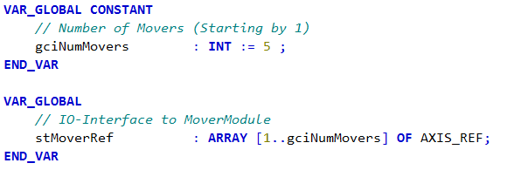
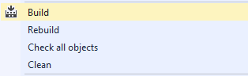
XTS AXIS_REF
AXIS_REF for linking the PLC with the Axis
definition of AXIS_REF
AXIS_REF is an interface between the PLC and the NC. It is added to MC function blocks as axis reference.

Slide 9
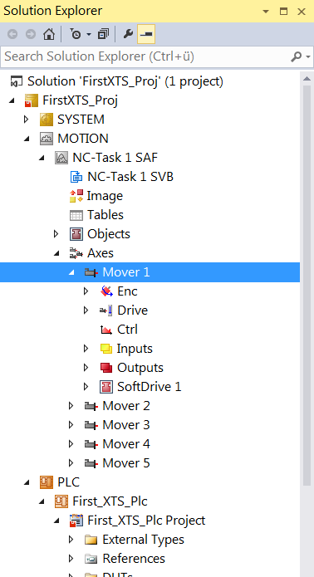
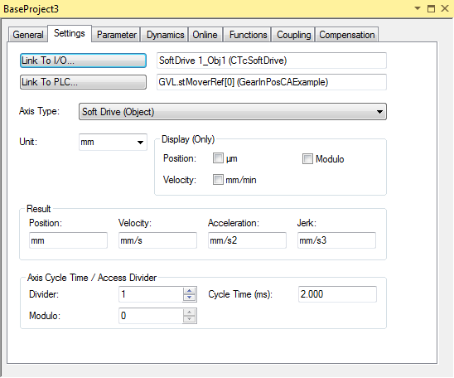
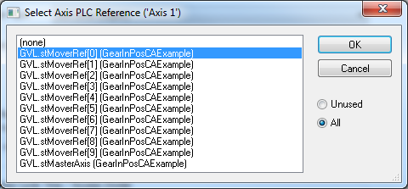
XTS AXIS_REF
AXIS_REF for linking the PLC with the Axis
link the AXIS_REF to the Axis (Mover)

Slide 10
Agenda | XTS – PLC
PLC-Library XTS
AXIS_REF
XTS-Utility Library
PLC StartUp condition
Mover1 detection via PLC
Overview TF5400 Collision Avoidance (CA)
CA-Group Object
PLC-Library CA-Group
AXES_GROUP_REF
CA-Group handling
CA-Operation

Slide 11
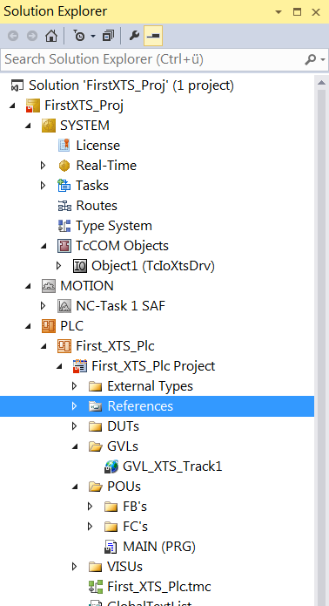
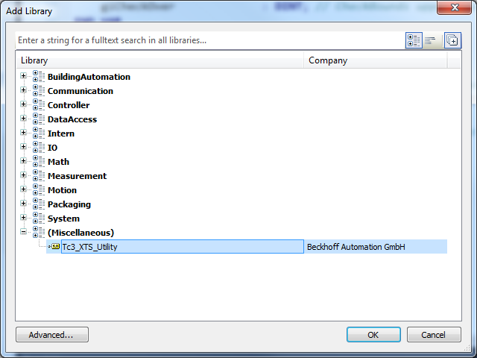
XTS XTS-Utility Library
XTS-Utility PLC-Libraries

Slide 12
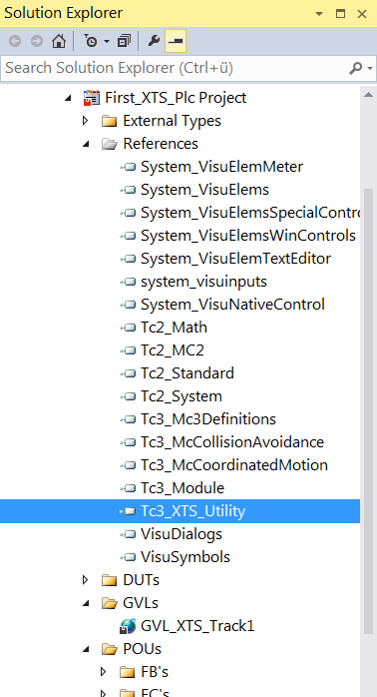
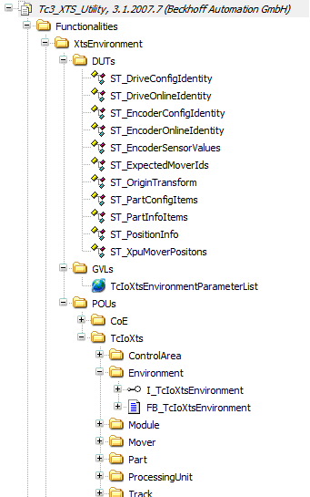
XTS XTS-Utility Library
XTS-Utility PLC-Libraries contains
DUTs
GVLs
TcIoXtsEnvironmentParameterList
POUs
FB_TcIoXtsEnvironment

Slide 13
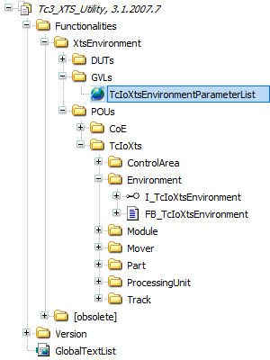
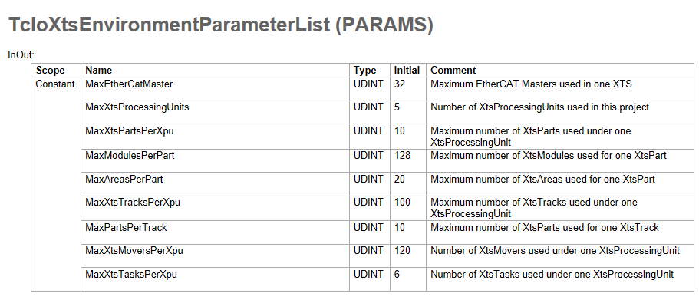
XTS XTS-Utility Library
TcIoXtsEnvironmentParameterList
The constant list can be changed in the library.
The parameters must be adapted for the respective system

Slide 14
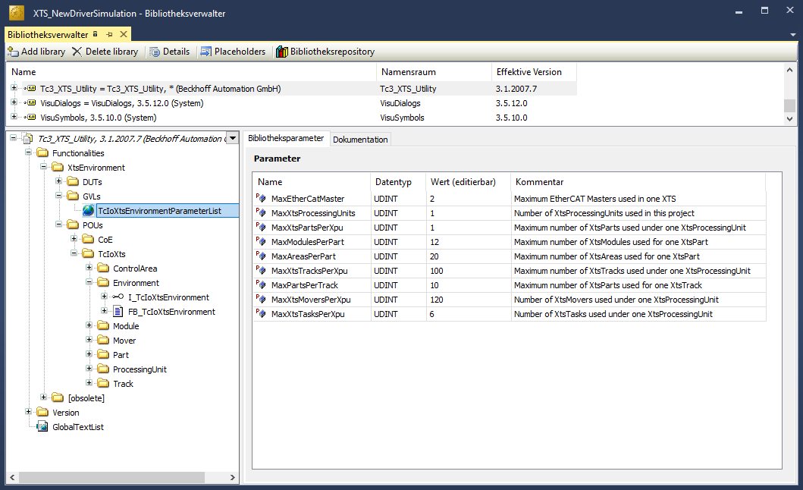
XTS XTS-Utility Library
TcIoXtsEnvironmentParameterList
To change this Parameters
“Double-click” the entry within the library.

Slide 15
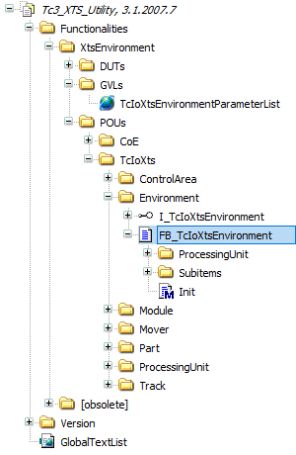
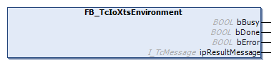
XTS XTS-Utility Library
FB_TcIoXtsEnvironment
For easy gathering of XTS diagnostic data and accessing object parameters in the PLC.

Slide 16
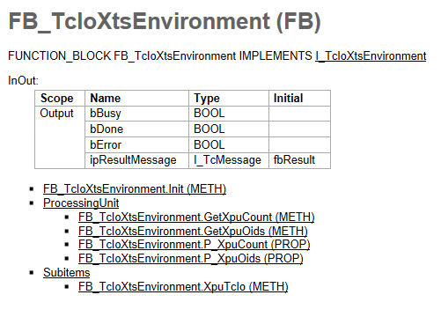
XTS XTS-Utility Library
FB_TcIoXtsEnvironment

Slide 17
XTS XTS-Utility Library
FB_TcIoXtsEnvironment
only one FB_TcIoXtsEnvironment is needed the XTS project. From this FB, all the XtsProcessingUnits and other objects can be accessed
Once initialized, the Function Block have access to all the connected objects of the XtsEnvironment structure and their methods.
There is no automatic cyclic update for data!
The user can use the methods to get the required information if necessary.

Slide 18



XTS XTS-Utility Library
Communication via FB_TcIoXtsEnvironment
XtsProcessingUnit ObjId
FB_TcIoXtsEnvironment
Xts Part
ObjId
Init
Module1_Obj1 ObjId
…
Mover1 ObjId
…
Axis AxisId
Modul AT2001-0250 ObjId
SoftDrv ObjId
Modul AT2000-0250 ObjId
…
…

Slide 19
XTS XTS-Utility Library
FB_TcIoXtsEnvironment
declaration
cal in Main()
// XTS Utility
VAR_GLOBAL
fbXtsEnvironment : FB_TcIoXtsEnvironment;
{attribute 'init_on_onlchange'}
bInit : BOOL := FALSE;
END_VAR
// Cal FB_XtsEnvironment
// Trigger only once in init
IF NOT bInit THEN
IF fbXtsEnvironment.Init(TRUE) THEN
fbXtsEnvironment.Init(FALSE);
bInit := TRUE;
END_IF
// If not yet initalized, dont‘t execute any of the XtsUtility code
RETURN;
END_IF

Slide 20
XTS XTS-Utility Library
FB_TcIoXtsEnvironment
The FB_TcIoXtsEnvironment is seen as a hub function block for all XTS relatedobjects within the project.
Each object has its respective function block (e.g.FB_TcIoXtsProcessingUnit) in the PLC. They can either be accessed via theFB_TcIoXtsEnvironment but also can be used standalone.

Slide 21
XTS XTS-Utility Library
FB_TcIoXtsEnvironment
To access the methods and gather the data easily, the below call chain can be followed which is very close to the actual object structure within the project:
fbTcIoXtsEnvironment.
XpuTcIo(n).
PartTcIo(n).
Module(n).
ModuleCoE(n).
ControlAreaTcIo(n).
TrackTcIo(n).
MoverTcIo(n).

Slide 22
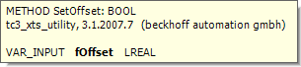
XTS XTS-Utility Library
Read/Write Parameter via FB_TcIoXtsEnvironment
read parameter
write parameter
// Position valid
bAllPositionsValid :=
fbXtsEnvironment.XpuTcIo(1).GetAreAllPositionsValid();
// Position valid
bTeachingValid:=
fbXtsEnvironment.XpuTcIo(1).GetIsTeachingValid();
// Set ModuleOffset
fbXtsEnvironment.XpuTcIo(1).PartTcIo(1).ModuleTcIo(1).SetOffset(fNewModuleOffset);

Slide 23
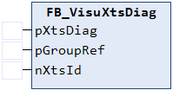
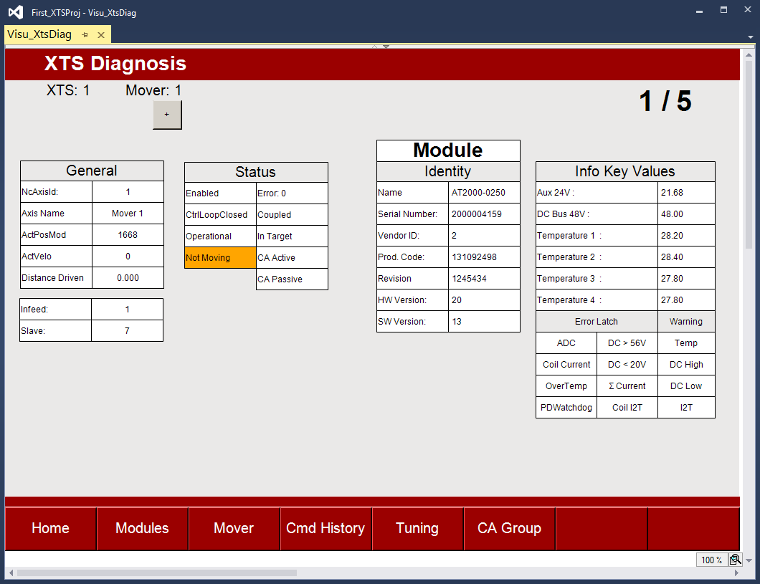
XTS XTS-Utility Library
FB_VisuXtsDiag & VI_XTSLib
FB_VisuXtsDiag collect all necessary Information from the XTS-Track
VI_XtsLib display all necessary Information from the XTS-Track inside of a PLC-Visualization (templet)
Coming soon

Slide 24
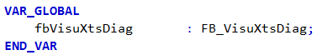
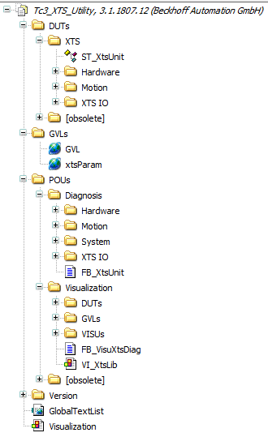
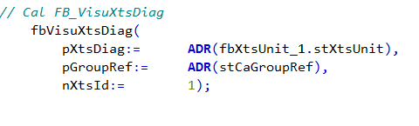
XTS XTS-Utility Library
FB_VisuXtsDiag
definition as GlobalVar
cal in Main()

Slide 25
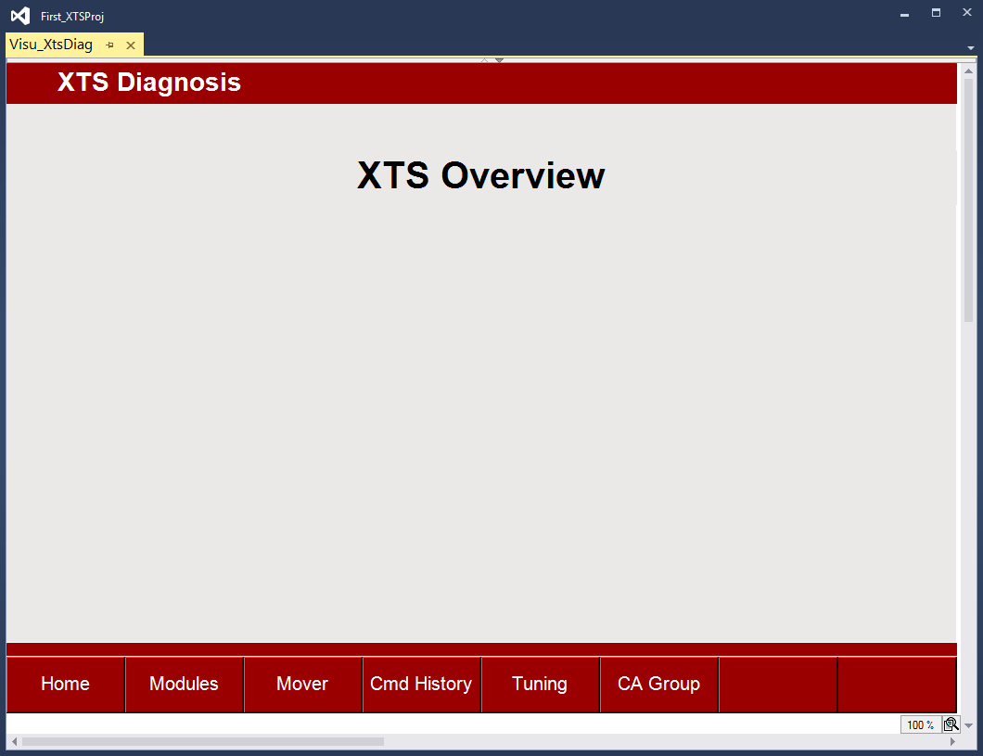
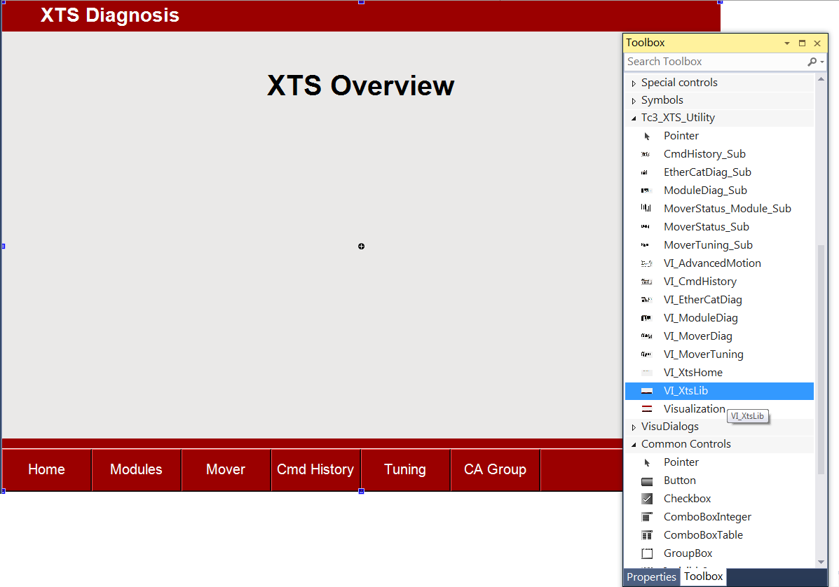
XTS XTS-Utility Library
VI_XtsLib
create in an PLC-Visualization

Slide 26

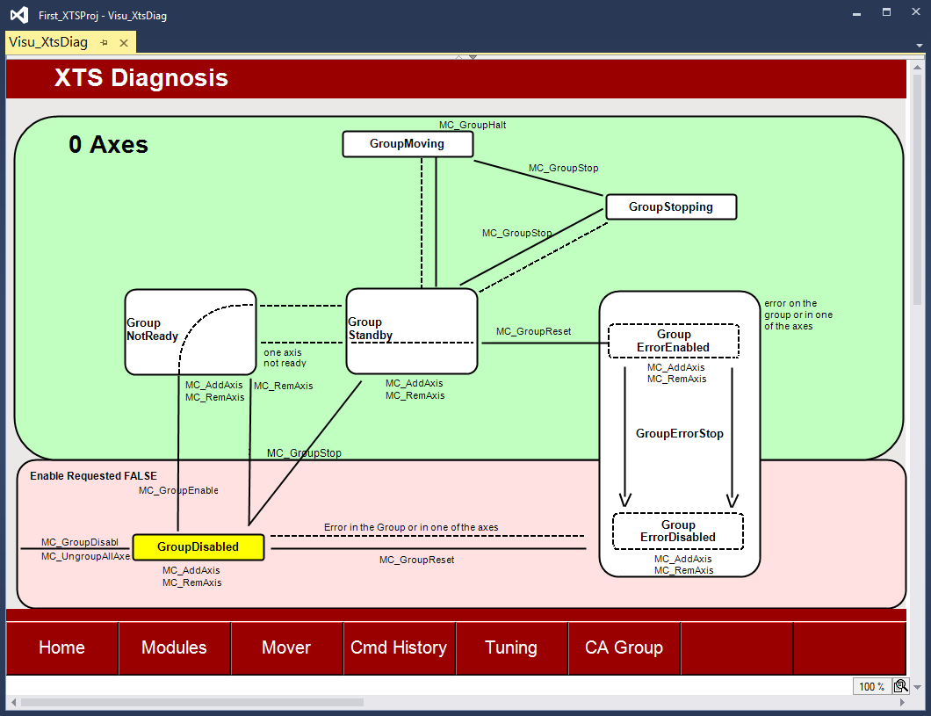
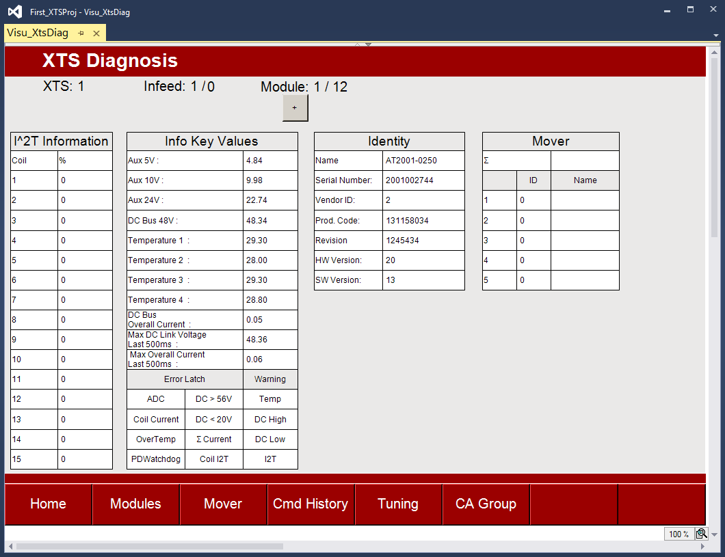
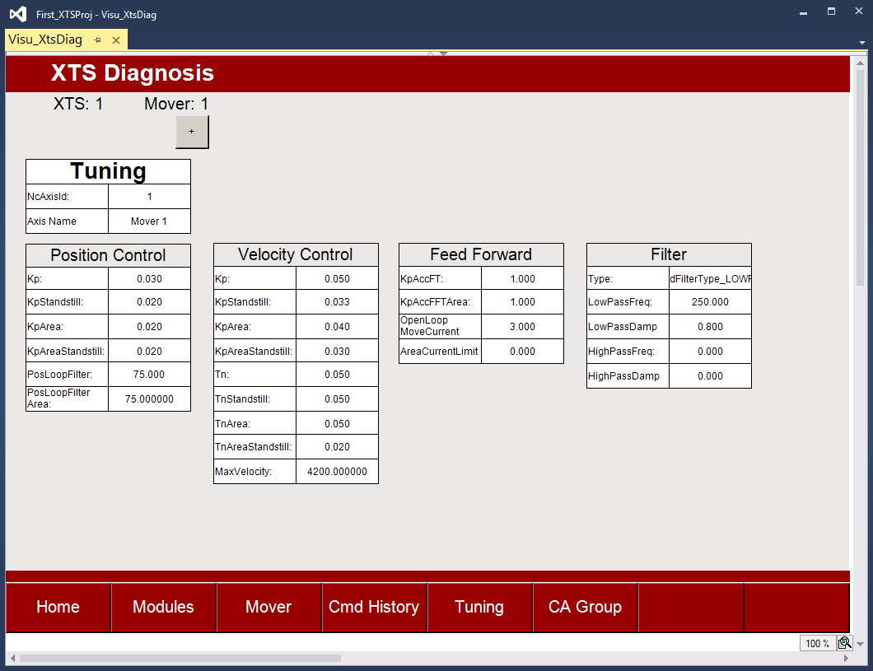
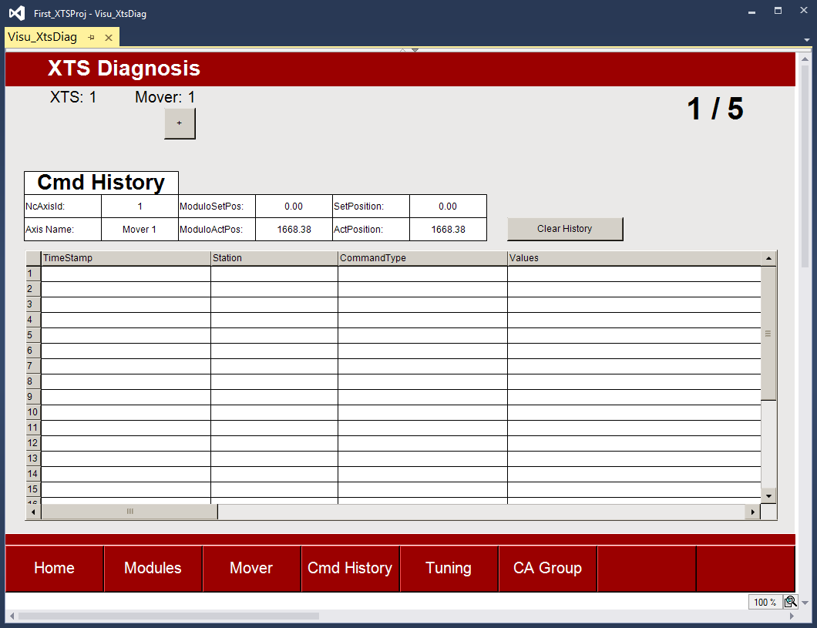
XTS XTS-Utility Library
VI_XtsLib

Slide 27
Agenda | XTS – PLC
PLC-Library XTS
AXIS_REF
XTS-Utility Library
PLC StartUp condition
Mover1 detection via PLC
Overview TF5400 Collision Avoidance (CA)
CA-Group Object
PLC-Library CA-Group
AXES_GROUP_REF
CA-Group handling
CA-Operation

Slide 28
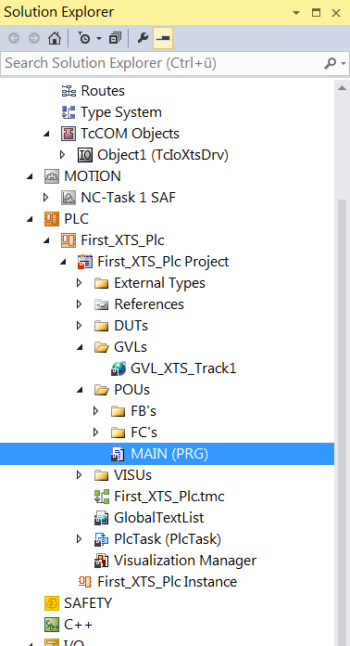
XTS PLC StartUp condition
XTS- Start Up Condition
The XTS I/O Driver requires time to find all of the movers on the track. During this process the XTS Task will exceed its cycle time, preventing the PLC Task from running normally.
Therefore, the PLC program should not execute any logic until the XTS Task has successfully located all the configured movers
// Check if the position detection of the Movers has been completed.
IF NOT fbXtsEnvironment.XpuTcIo(1).GetAreAllPositionsValid()
OR NOT fbXtsEnvironment.XpuTcIo(1).GetIsTeachingValid()
OR NOT ( fbXtsEnvironment.XpuTcIo(1).GetDetectedMoverCount() =
fbXtsEnvironment.XpuTcIo(1).GetExpectedMoverCount() ) THEN
// If not all Mover positions are valid, do not process any further.
RETURN;
END_IF

Slide 29
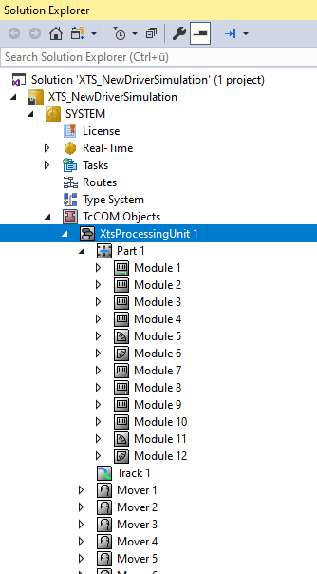
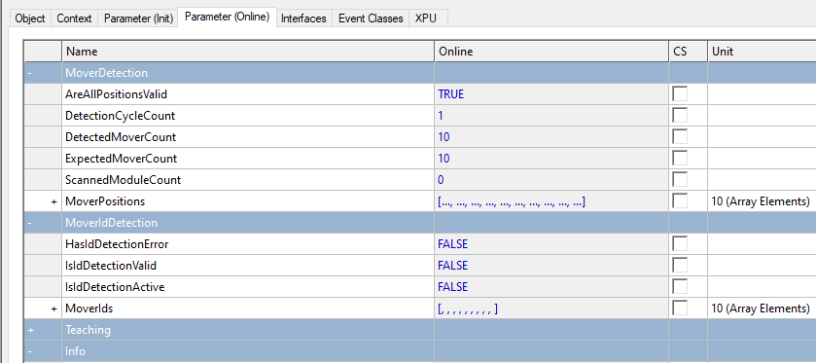
XTS PLC StartUp Delay
XTS- StartUp Delay
The actual state of the XTS-System are shown in “Parameter (Online)” for e.g.:
AreAllPositionsValid
DetectionCycleCount
DetectedMoverCount
ExpectedMoverCount
ScannedModuleCount

Slide 30
Agenda | XTS – PLC
PLC-Library XTS
AXIS_REF
XTS-Utility Library
PLC StartUp condition
Mover1 detection via PLC
Overview TF5400 Collision Avoidance (CA)
CA-Group Object
PLC-Library CA-Group
AXES_GROUP_REF
CA-Group handling
CA-Operation

Slide 31
XTS Mover1 detection via PLC
Mover1 detection via PLC
// Mover1 detection
// Check if "MoverIdDetectionMode" has been activated under the XtsProcessingUnit object.
IF fbXtsEnvironment.XpuTcIo(1).GetMoverIdDetectionMode() = MoverIdDetectionMode.Mover1 THEN
// Check if the "MoverIdDetection" has already been started or the Mover1 was found.
IF bStartMoverIdDetection AND NOT (bMoverIdDetectionActive OR bMoverIdDetected) THEN
bStartMoverIdDetection := FALSE;
// Trigger the "MoverIdDetection".
fbXtsEnvironment.XpuTcIo(1).TriggerMoverIdDetection();
END_IF
// Check for error or success of "MoverIdDetection".
// If the detection has an error, check for errors in output and try again.
IF fbXtsEnvironment.XpuTcIo(1).GetHasMoverIdDetectionError() THEN
RETURN;
END_IF
// Do not process any further until the "MoverId" was deteced.
IF NOT fbXtsEnvironment.XpuTcIo(1).GetIsMoverIdDetectionValid() THEN
RETURN;
END_IF
// If the "MoverIdDetection" was not activated in the XtsProcessingUnit object,
// then the activation of the "MoverIdDetection" and the search of Mover1 is skipped.
ELSE
;
END_IF

Slide 32
Agenda | XTS – PLC
PLC-Library XTS
AXIS_REF
XTS-Utility Library
PLC StartUp condition
Mover1 detection via PLC
Overview TF5400 Collision Avoidance (CA)
CA-Group Object
PLC-Library CA-Group
AXES_GROUP_REF
CA-Group handling
CA-Operation

Slide 33
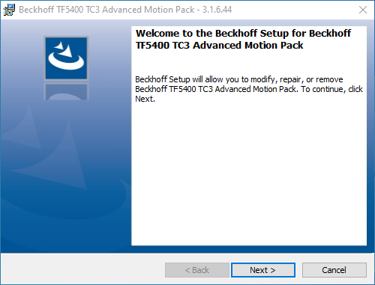
XTS – Collision Avoidance
TC3 Motion Collision Avoidance as TcCOM Module (TwinCAT Component Object Models
TF5400 | TC3 Advanced Motion Pack
Included
TC3 Kinematic Transformation
TC3 Motion Collision Avoidance
TC3 Motion Pick-and-Place
TC3 Planar Motion

Slide 34
XTS – Collision Avoidance
Collision Avoidance Overview
The purpose of collision avoidance is to prevent collisions between movers, and also to maintain a parameterized “Gap” between any two movers.
Therefor PTP axes are added to a CA (collision avoidance) group.
Motion function blocks for collision avoidance are included in library Tc3_McCollisionAvoidance.
Administrative function blocks are included in library Tc3_McCoordinatedMotion.
For detailed collision avoidance information see the online Beckhoff Information System section on Advanced Motion
Link to Infosys

Slide 35
Agenda | XTS – PLC
PLC-Library XTS
AXIS_REF
XTS-Utility Library
PLC StartUp condition
Mover1 detection via PLC
Overview TF5400 Collision Avoidance (CA)
CA-Group Object
PLC-Library CA-Group
AXES_GROUP_REF
CA-Group handling
CA-Operation

Slide 36
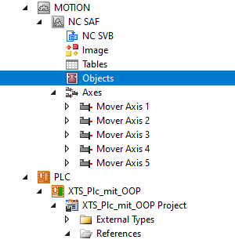
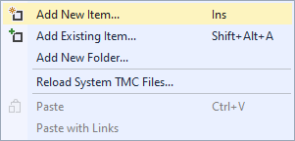
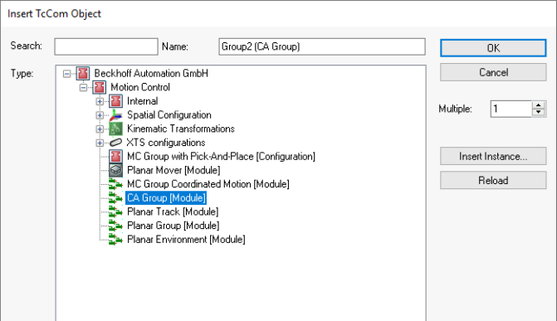
XTS Collision Avoidance
Adding the CA Group Object

Slide 37
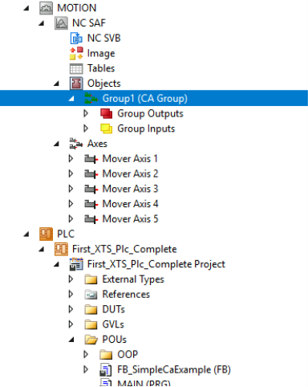
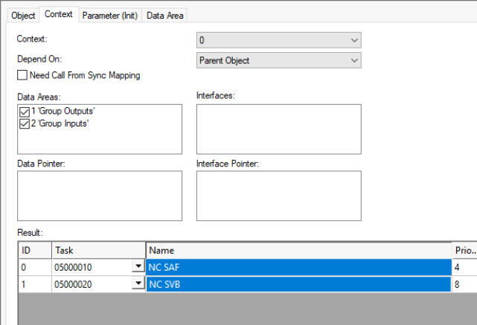
XTS Collision Avoidance
Set the Context of the Collision Avoidance group to the NC-SAF Task

Slide 38
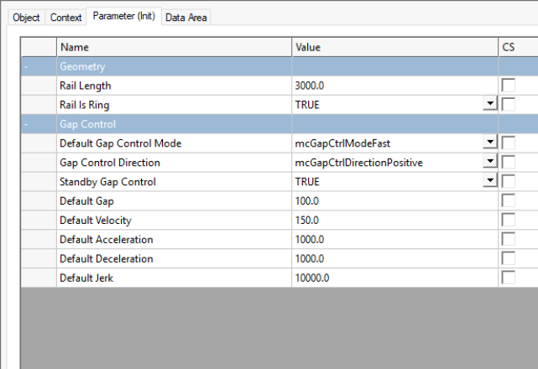
XTS Collision Avoidance
Collision Avoidance Group Settings
The CA Group has 4 key settings.
Rail Length (Same as the HardwareModulo)
Rail is a ring
Gap Control Mode
mcGapCtrlModeStandard
mcGapCtrlModeFast
Standby Gap Control

Slide 39
Agenda | XTS – PLC
PLC-Library XTS
AXIS_REF
XTS-Utility Library
PLC StartUp condition
Mover1 detection via PLC
Overview TF5400 Collision Avoidance (CA)
CA-Group Object
PLC-Library CA-Group
AXES_GROUP_REF
CA-Group handling
CA-Operation

Slide 40
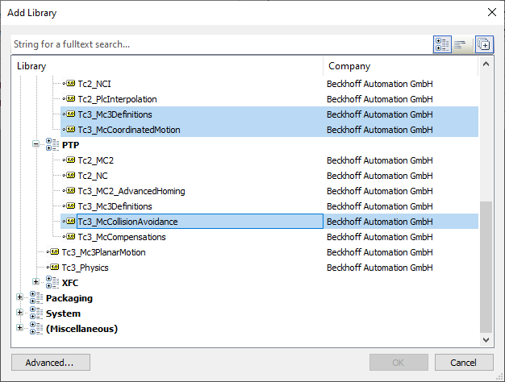
XTS PLC Libraries
Necessary PLC-Libraries Collision Avoidance

Slide 41
XTS PLC Libraries
Necessary PLC-Libraries Collision Avoidance
Tc3_McCollisionAvoidance
Library containing control function blocks for Collision Avoidance
Tc3_McCoordinatedMotion
Library containing control function blocks for Axis Group handling
Tc3_Mc3Definitions
Library with definition for the motion functions

Slide 42
Agenda | XTS – PLC
PLC-Library XTS
AXIS_REF
XTS-Utility Library
PLC StartUp condition
Mover1 detection via PLC
Overview TF5400 Collision Avoidance (CA)
CA-Group Object
PLC-Library CA-Group
AXES_GROUP_REF
CA-Group handling
CA-Operation

Slide 43
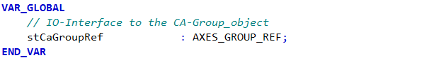
XTS AXES_GROUP_REF
AXES_GROUP_REF for linking to the CA Group Object
definition of AXES_GROUP_REF
AXES_GROUP_REF interface provides the cyclical data exchange between PLC and a NC group object.

Slide 44
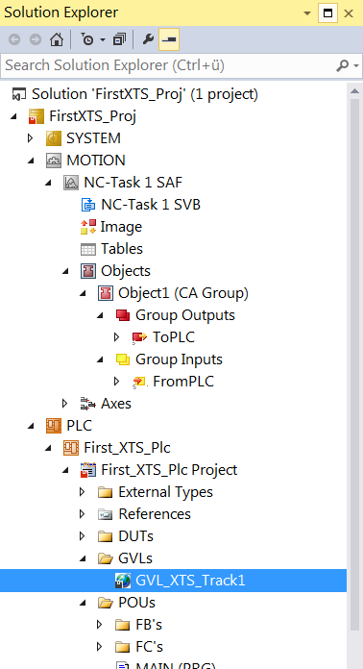
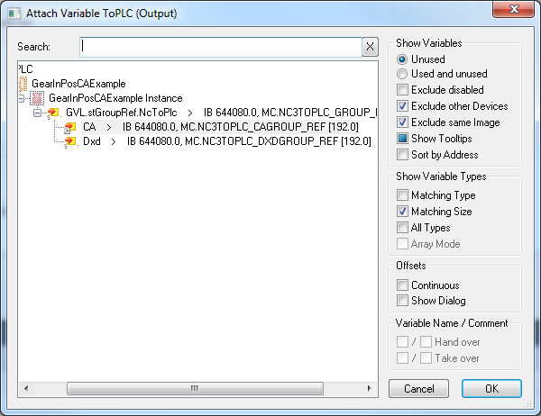
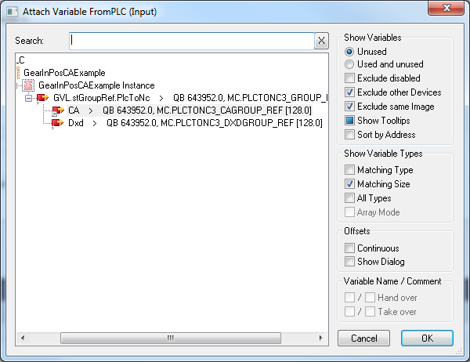
XTS AXES_GROUP_REF
AXES_GROUP_REF for linking then PLC with the CA Group Object
link the AXES_GROUP_REF to the CA-Group

Slide 45
Agenda | XTS – PLC
PLC-Library XTS
AXIS_REF
XTS-Utility Library
PLC StartUp condition
Mover1 detection via PLC
Overview TF5400 Collision Avoidance (CA)
CA-Group Object
PLC-Library CA-Group
AXES_GROUP_REF
CA-Group handling
CA-Operation

Slide 46

XTS CA-Group handling
Collision avoidance State Model

Slide 47
XTS CA-Group handling
Collision avoidance State Model
There are effectively 3 Group states that effect a Collision Avoidance axis.
Operational (Standby or Moving)
GroupErrorState (Faulted and Enabled, Faulted with Disable Pending, Faulted with Ungroup all pending)
Group Disabled (with at least 1 Axis or without any axis)

Slide 48
XTS CA-Group handling
Collision Avoidance State Model
A group without any axes is always disabled - it cannot be enabled.
GroupNotReady is a short transitional state or waiting for axis to be enabled.
GroupErrorState is a special state. The only method to leave this state is to issue a GroupReset.
However, Group Reset will have different outcomes depending on the next requested or required state.

Slide 49


XTS CA-Group handling
Collision Avoidance State Model
simpler presentation (State diagram valid for V3.1.10)

Slide 50
XTS CA-Group handling
Full Sequence
MC_AddAxisToGroup()
MC-Reset() / MC_Power() Enable Axis
MC_GroupEnable()
Collision Avoidance Active
MC2 command
Collision Avoidance Passiv
MC_MoveAbsoluteCA()
MC_GearInPosCA()
MC_MoveAbsolute()
MC_CamIn()
MC CA command
MC_GearIn()
MC_...()
MC_HaltCA()
MC_GroupDisable()
MC_RemoveAxisFromGroup()
MC_Power() Disable Axis

Slide 51
XTS CA-Group handling
Full Sequence
Startup Sequence:
Add All Axes to the group
Reset/Enable All axes (ensure all axes are enabled and error free)
Enable the Group
MC_AddAxisToGroup()
MC-Reset() / MC_Power() Enable Axis
MC_GroupEnable()
Collision Avoidance Active
MC_MoveAbsoluteCA()
MC_GearInPosCA()
MC_HaltCA()

Slide 52
XTS CA-Group handling
Full Sequence
Collision avoidance is active :
If Standby Gap is active the movers will separate
Should a failure occur, GroupReset will return the system to the running state
Collision Avoidance Active
MC_MoveAbsoluteCA()
MC_GearInPosCA()
MC_HaltCA()

Slide 53
XTS CA-Group handling
Full Sequence
By using a MC2-Command the axis change in “CA-Passiv”
With using a MC_CA-Command the Axis change in “CA-Active”
Collision Avoidance Active
MC2 command
Collision Avoidance Passiv
MC_MoveAbsoluteCA()
MC_GearInPosCA()
MC_MoveAbsolute()
MC_CamIn()
MC CA command
MC_GearIn()
MC_...()
MC_HaltCA()

Slide 54
XTS CA-Group handling
Full Sequence
Reset or Shutdown Sequence:
Halt-Command for all Movers
Disable Group
Remove all Axes from Group
Disable Axes
Collision Avoidance Active
MC_MoveAbsoluteCA()
MC_GearInPosCA()
MC_HaltCA()
MC_GroupDisable()
MC_RemoveAxisFromGroup()
MC_Power() Disable Axis

Slide 55
Agenda | XTS – PLC
PLC-Library XTS
AXIS_REF
XTS-Utility Library
PLC StartUp condition
Mover1 detection via PLC
Overview TF5400 Collision Avoidance (CA)
CA-Group Object
PLC-Library CA-Group
AXES_GROUP_REF
CA-Group handling
CA-Operation

Slide 56


XTS CA-Operation
MC_MoveAbsoluteCA Moves a single axis to an absolute position with collision avoidance.
MC_MoveRelativeCA Moves a single axis over a relative distance with collision avoidance.
MC_HaltCA Stops a single axis with collision avoidance without locking it for further motion commands.
MC_GearInPosCA Couples a slave axis with a gearing factor and collision avoidance to a master axis.

Slide 57

XTS CA-Operation
MC_MoveAbsoluteCA
This function block commands the specified mover to the specified absolute position according to the parameterized gap of the collision avoidance input.
The collision avoidance functionality has higher priority than the absolute motion command.
During execution of the move, the axis may slow down or stop and wait to avoid a collision. The axis will prioritize maintaining the gap overreaching the destination position.
When the path is clear the axis will complete the absolute position command.
The Done output of the function block will become True when the target position has been reached.

Slide 58



XTS CA-Operation
MC_MoveAbsoluteCA
Mover 9 is free to move towards the target position of 2000 with a velocity of 1000.
Once the target position is reached, Done becomes True and Busy and Active become False.
The move has been completed successfully and mover 9 is now at position 2000.

Slide 59



XTS CA-Operation
MC_MoveAbsoluteCA
Mover 8 is commanded to move to the same position as Mover 9; however, Mover 9 is in the way. Collision Avoidance will prevent Mover 8 from reaching position 2000 but it will also prevent Mover 8 from colliding with Mover 9.
The profile of Mover 8 will look as follows.
Mover 8 stops to maintain the gap spacing but the Active bit and the Busy bit remain true and Done remains false.
This move is not complete.

Slide 60



XTS CA-Operation
MC_MoveAbsoluteCA
Mover 9 is free to move towards the target position of 2500 with a velocity of 1000.
Mover 9 starts to move out of the way.
Mover 8 begins to move, ramps up its velocity and then stops in its final target position, “2000”.
Mover 8’s Busy and Active bits become false and the done bit for Mover 8 is set.
Mover 8’s mover is now complete.
Then finally mover 9 completes its commanded move.

Slide 61

XTS CA-Operation
MC_GearInPosCA
This function block couples a slave axis to a master axis.
The set values for both axes are calculated based on the master axis set values.
Like all collision avoidance commands, priority is given to satisfying collision avoidance.
Completion of the commanded move occurs when there is no possibility of striking another axis or violating the collision avoidance gap.

Slide 62

XTS CA-Operation
MC_GearInPosCA
A typical use for the MC_GearInPosCA block is to synchronize a mover to a product on a conveyor. To accomplish this, the conveyor is equipped with a servo motor or encoder and a sensor is used to mark positions of products on the conveyor.
In all cases, Gap control overrides the move command, if the mover would approach another axis, it will slow down regardless of the command issued.

Slide 63
XTS CA-Operation
MC_GearInPosCA
Input „SyncStrategy“
from Type MC_SYNC_STRATEGY
This data type defines the synchronization profile of the slave
TYPE MC_SYNC_STRATEGY
mcSyncStrategyLate | 16#1
mcSyncStrategySlow | 16#2
mcSyncStrategyEarly | 16#3

Slide 64

XTS CA-Operation
MC_GearInPosCA
mcSyncStrategyLate
The slave starts the synchronization as late as possible and with full dynamics (according to the input values velocity, acceleration, deceleration, jerk).
It reaches the SlaveSyncPosition just in time with the correct gear ratio.

Slide 65

XTS CA-Operation
MC_GearInPosCA
mcSyncStrategySlow
The slave starts its sync in motion as soon as the master passes the MasterStartDist (MasterSyncPosition - MasterStartDistance). If the MasterStartDist is not set then the motion begins as soon as the FB is Active.
The dynamics of the slave are reduced such that the slave reaches the SlaveSyncPos with the correct gear ratio just in time when the master reaches the MasterSyncPos.

Slide 66

XTS CA-Operation
MC_GearInPosCA
mcSyncStrategyEarly
The slave starts its motion as soon as the master passes the MasterStartDist. If the MasterStartDist is not set then the motion begins as soon as the FB is Active.
The dynamics are not reduced.
The slave signals earlier InSync than demanded by the SlaveSyncPosition, but it is still guaranteed that the demanded offset between master and slave (MasterSyncPosition – SlaveSyncPosition)
is reached with the correct gear ratio.

Slide 67

XTS | New Freedom in Machine Building
Complex sequences – simplified solution: XTS

Slide 68
Training material
This training material is provided to complement the presented training content. Outside the actual training the material may only be used for internal purposes at the company of the course participant. In addition, the material or extracts thereof may be used in end customer training for products containing Beckhoff products, or for presentations, provided the presentation refers to Beckhoff products. Extracts or copies of the training material must contain the following copyright acknowledgement: “© Beckhoff Automation GmbH & Co. KG”.
The same applies to extracts from presentation material. The user of the material is solely responsible for the completeness of extracts and copies. It is explicitly not permitted to offer commercial or free training for Beckhoff products. This applies to training with and or without the training material. The training material must not be edited, manipulated or modified.
Passing on of the aforementioned rights to third parties is not permitted.
Beckhoff Automation GmbH & Co. KG

Slide 69
02/2021

